Slide 1
Spot on Update
Student name: Raj kumar Bhukya
Student id:W9598301

Slide 2
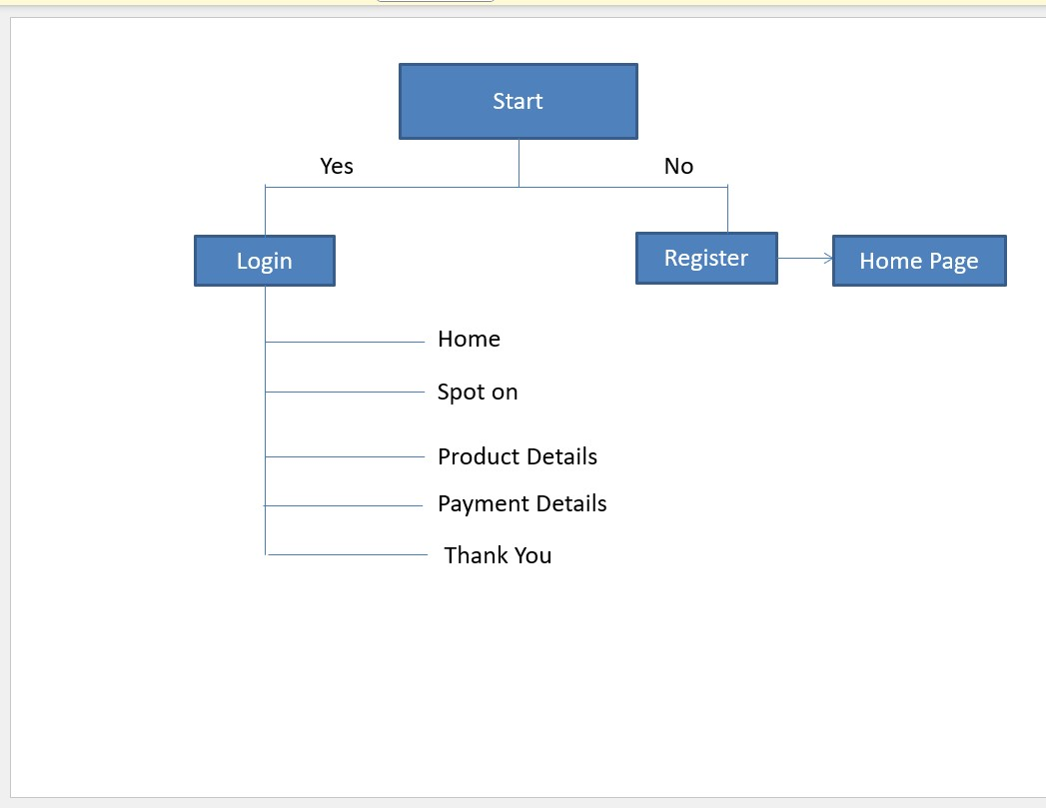
Activity Flow Diagram

Slide 3
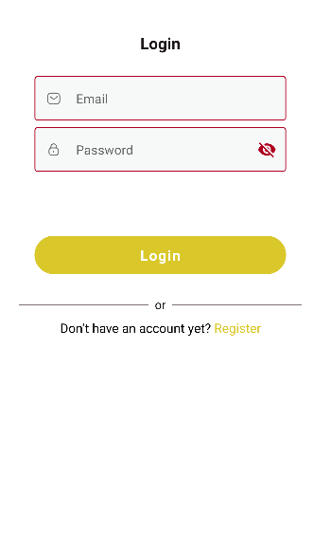
Login Page
The login page will let the user enter the app to do the shopping. The user will be able to login if they are already registered, or they will be asked to sign up if not registered previously. The user can register by clicking on the sign-up button which is available at the bottom.

Slide 4
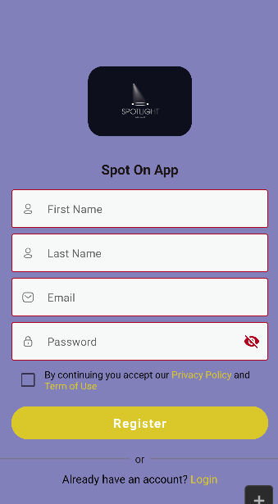
Registration Page
The registration page is used to get registered with the application. The user needs to provide the basic information like name, email, and mobile number to get started with. Once the registration is done, the next step is to login to the application with the email id and password used at the time of registration.

Slide 5
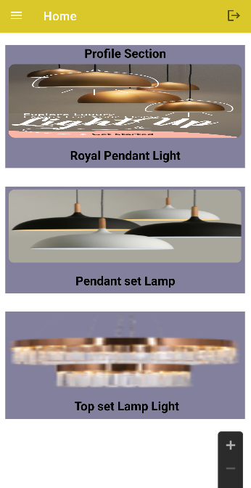
Home Page
The next step is to check the home page after the successful login. The user will be redirected to the home page, and they can explore a range of popular products, navigation bar at the bottom and search bar for searching the products.

Slide 6
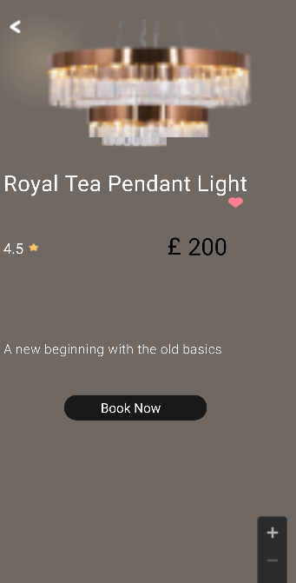
Product Details
The product details can be obtained by clicking on a product which will redirect to the product detail page. The user will be able to see the product in detail and can decide on purchasing the item. The user also can make use of the Wishlist button provided in the same page to add the product to the Wishlist for later reference.

Slide 7
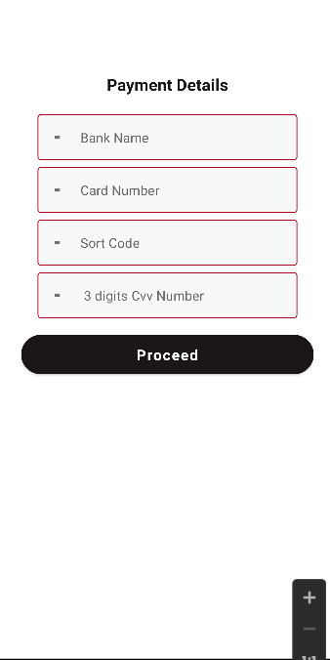
Payment Page
The payment page section is used to enter or edit user’s information. proceed button is navigated to the booking successful page

Slide 8
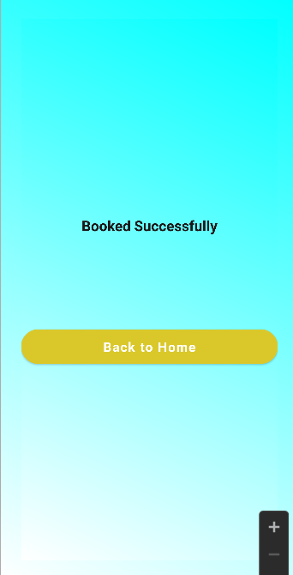
Order Successful Page
In the home page bottom navigation there will be a profile icon. By clicking on the icon user will be redirected to the profile page of the application. In the profile page user can add the profile photo and can edit the name and the mobile number.
Once the interested products are selected and ordered successfully, the user will see a page called ‘order successful page’. Here, they will see the thank you and order placed confirmation message. The user can now go back and continue browsing products or do shopping.

Slide 9
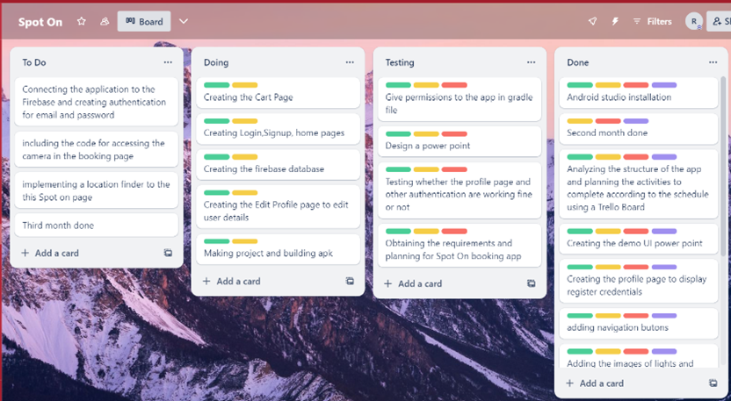
Development Strategy phase 1

Slide 10
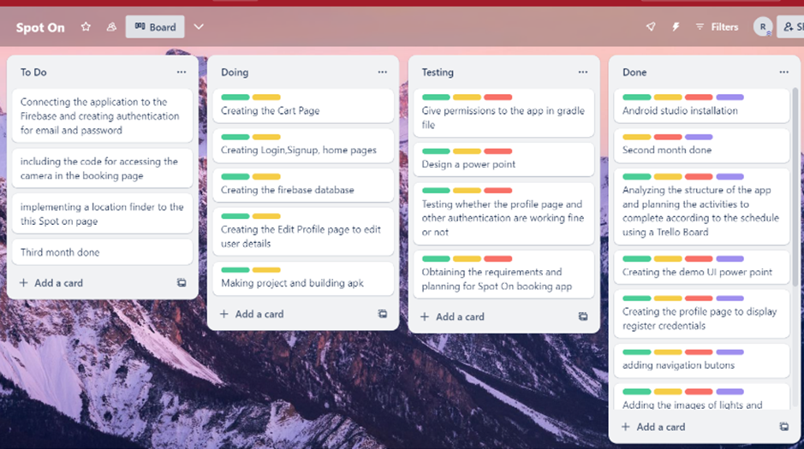
Development Strategy phase 2

Slide 11
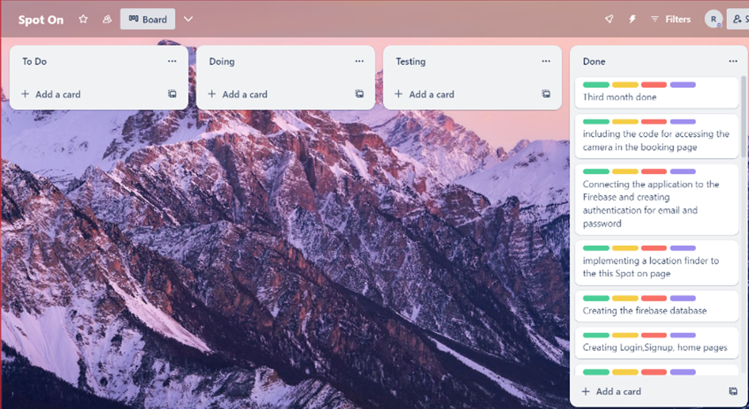
Development Strategy phase 3

Slide 12
Social and Ethical Issues
During the registration and login process, the user might be required to provide personal information such as their name, last name, and mobile number. Rest assured that this data is kept private and not shared (Chattell, 2016). To ensure safety, token-based APIs are used, and passwords are encrypted. To update profile pictures, the user may need to allow the application to access their gallery. Additionally, the location of the user may be tracked using their current location. However, permissions for these actions are provided and listed below.

Slide 13
References
Chattell, A., 2016. Creating value in the digital era: Achieving success through insight, imagination and innovation. Springer.

Slide 14

Thank you

